Slide 1
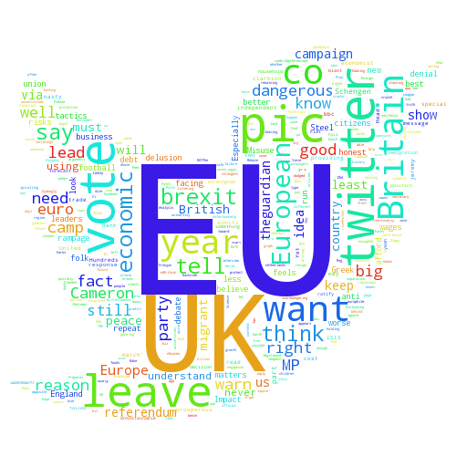

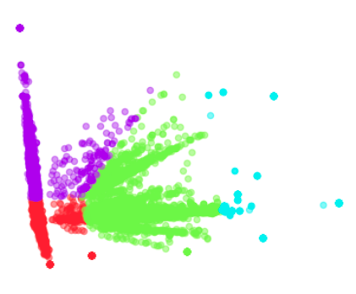
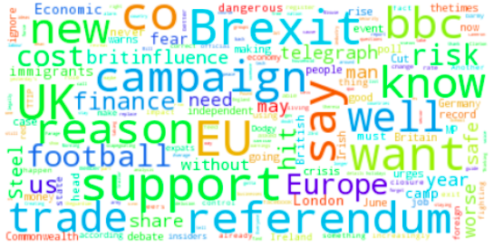

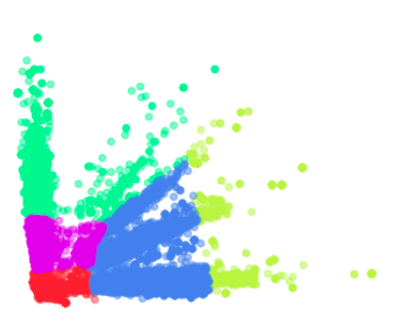
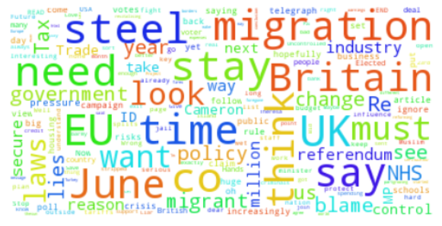

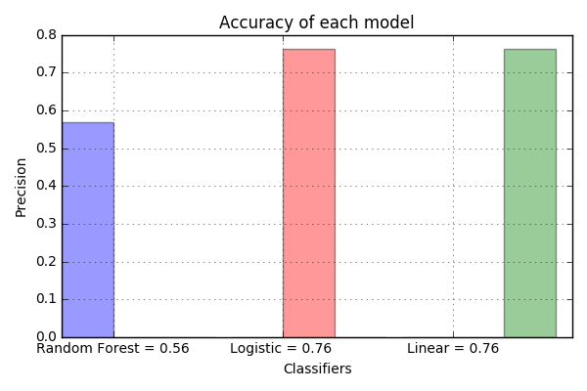
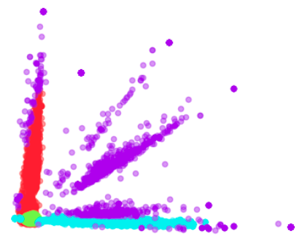
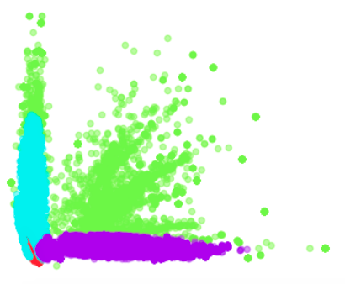


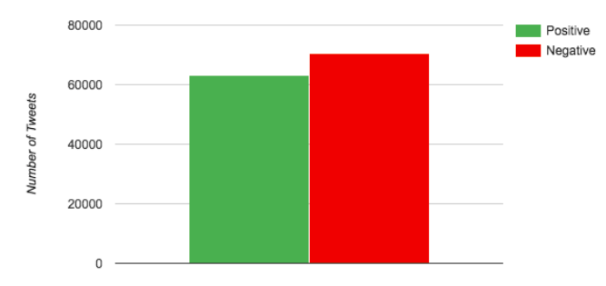
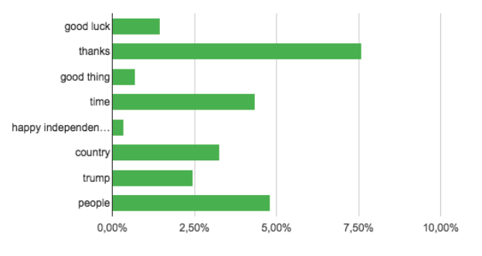
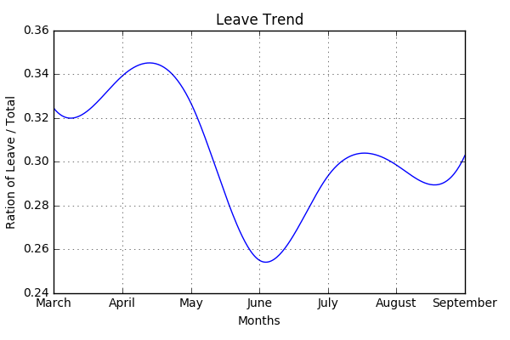
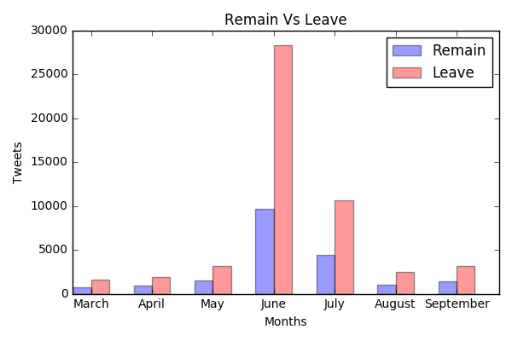
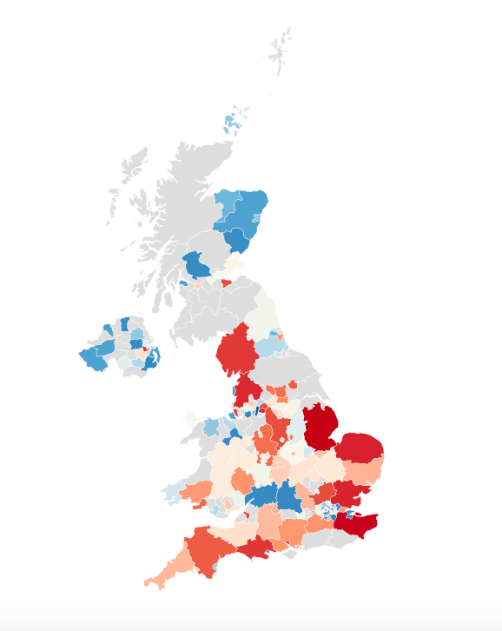
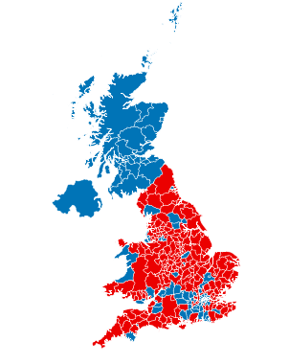

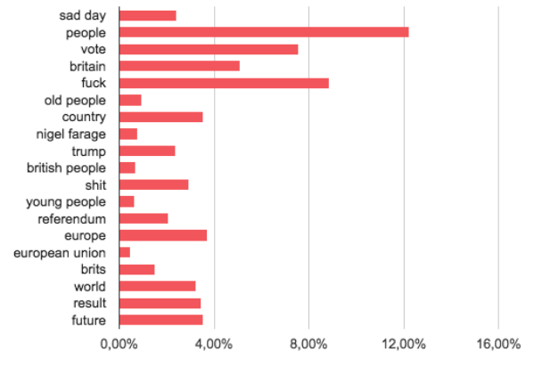
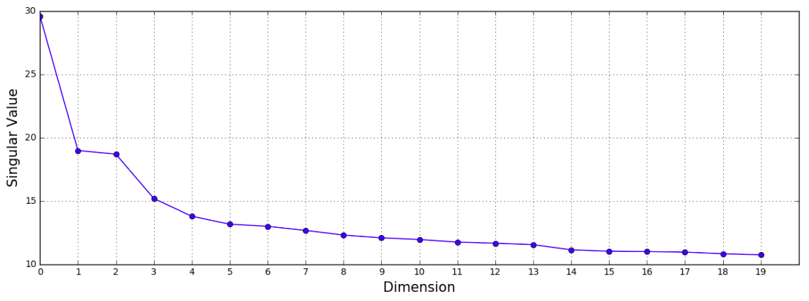
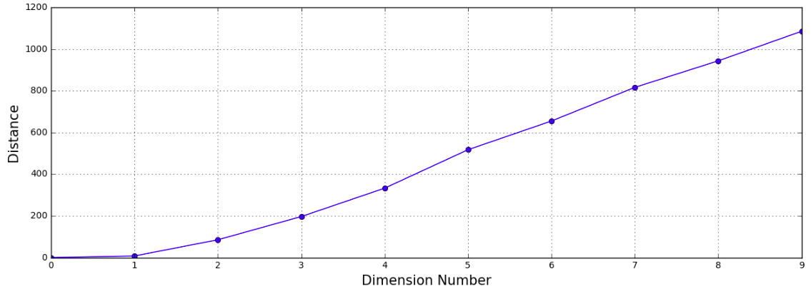
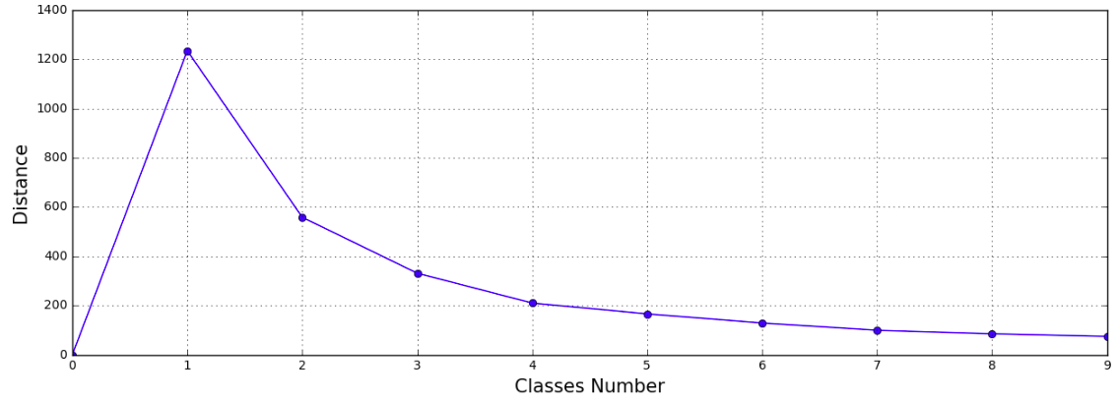

Twitter Based Brexit Analysis
Surya Vajjhala
Zhi Dou
Introduction
Model
Result
Problem :
• Analysis general attitude and trend towards Brexit
• Analysis main topic of both support and against Brexit classes
Approach :
• Scrape data from twitter
• Label data by sentiment analysis
• Classify unlabeled data and analysis trend
• Analysis main topic using clustering
Scrape and Label
• Implement scraper in python
• Scrape data with remain and leave hashtag separately and apply sentiment analysis on this data, then decide the label.
Classification
$$w=argmin\left|\left|wx−y\right|\right| s.t. y=wx$$
• Train linear regression as classifier
• Fine tune threshold for accuracy
Clustering
• Tokenize texts and reduce dimension by SVD
• Implement Kmeans and GMM clustering
Figure 6 Remain, Kmeans Cluster
Figure 7 Word Cloud
Dataset
• Label for remain: Economy, Trade; Financial; Banking; Independent
• Word Cloud: Trade, Economic; Dangerous, Risk, Critics; Football
Tweets :
• Each tweet contains attributes: text, location, created time, user ID, tweets ID and hashtag
• 120050 labeled tweets (23.7M) from March to September, 2016 with hashtag like: yes2eu, yestoeu, betteroffin, votein, for remain and no2eu, notoeu, betteroffout, voteout, for leave
• 71275 unlabeled tweets (12.7M) from March to September, 2016 with hashtag Brexit
Result
Classification
• Compare different classifier
Figure 8 Leave, Kmeans Cluster
Figure 9 Word Cloud
Three classifier:
• Random Forest
• Logistic Regression
• Linear Regression
• Label for leave: Refugee, Expense, Trade, Employment, Political Change
• Word Cloud: Migration, Laws, Tax, Britain, Control, Lies
Related Work
• GMM
Sentiment Analysis based :
• Performed sentiment analysis on these tweets to get polarity of each tweets, and get positive, negative classes
• Extract key words of tweets of different sentiments to get different different point of view
Figure 1 Comparison of Classifiers
• Apply Linear Regression on unlabeled data set
Show trend of remain and leave
Figure 11 Remain, GMM Cluster
Figure 12 Leave, GMM Cluster
• Label for leave: Control Border, Anti Democratic, Scare Tactics, Expense
• Label for remain: International Politics, David Cameron, Europe Family, Reform EU
• Distribution
Figure 2 Ratio of Remain to Leave
Figure 3 Trend of Remain to Leave
SVD Decomposition
• Compare different classifier
Potential Problem :
• Sentiment of tweets cannot fully reflect users’ attitude to Brexit
• Key words extraction basted on Sentiment might be unrelated to Brexit
• Top5 Corresponding Topic
Remain Leave
• Economy/Trade Freedom/Sovereignty/Great
• Jobs/Market/Risk Tax
• Law/Govern Economy/Trade
• Security Migrants
• Nation/Leader Lie/Brussels
Model
Result
Work Flow
• Scrape data and label
• Train classifier and predict unlabeled data
• Clustering inside each class to find main topic
• Kmeans Clustering
Both graph show people’s attitude towards Brexit. Red means support Brexit, and blue means against.
Left figure is what we get from our model, while right is from news
Figure 4 Distance, Dimension Number
Figure 5 Distance, Classes Number
Citation：
[1] http://www.investopedia.com/terms/b/brexit.asp
[2] http://www.networkworld.com/article/3088617/analytics/amazing-analysis-of-the-brexit-with-machine-learning.html

